Slide 1

Danny’s Diner SQL Case Study

Slide 2
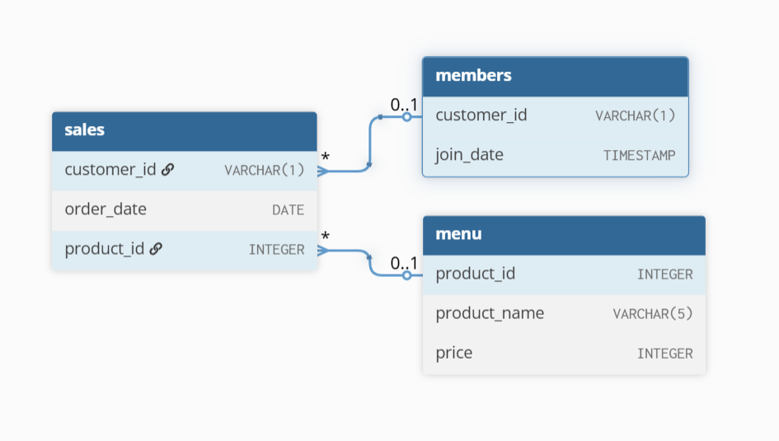
Entity Relationship Diagram

Slide 3
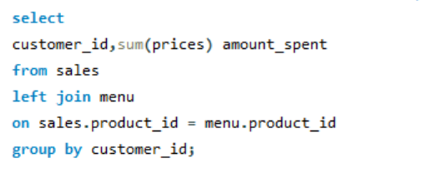
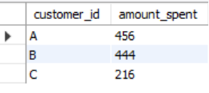
1. What is the total amount each customer spent at the restaurant?

Slide 4
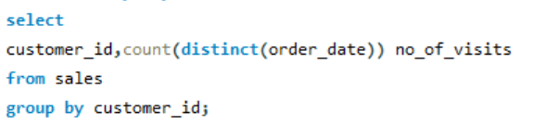
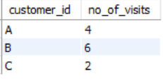
2. How many days has each customer visited the restaurant?

Slide 5
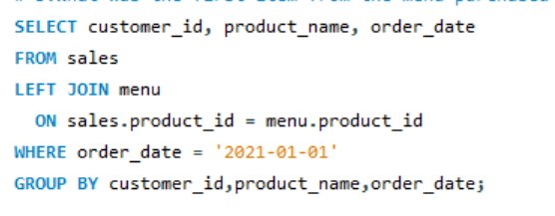
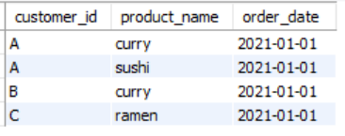
3. What was the first item from the menu purchased by each customer?

Slide 6
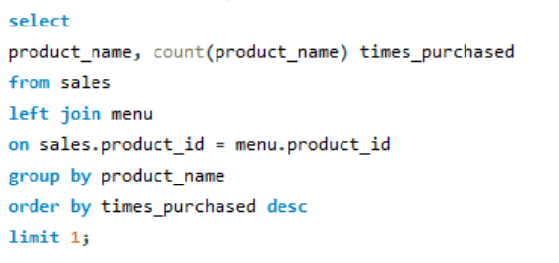

4. What is the most purchased item on the menu and how many times was it purchased by all customers?

Slide 7
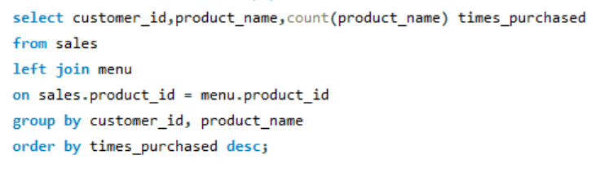
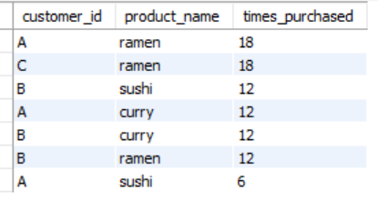
5. Which item was the most popular for each customer?

Slide 8
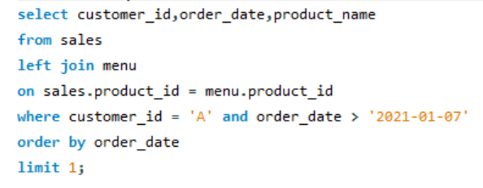

6. Which item was purchased first by the customer after they became a member?

Slide 9
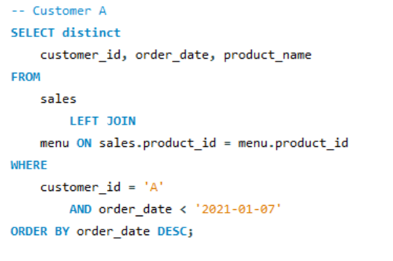
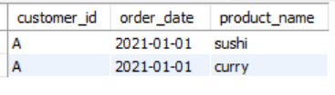
7. Which item was purchased just before the customer became a member?

Slide 10
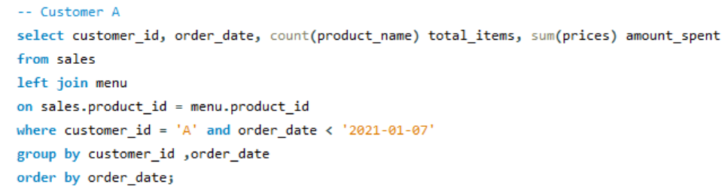

8. What is the total items and amount spent for each member before they became a member?

Slide 11
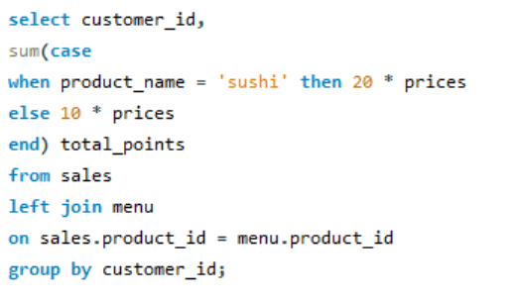
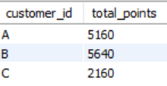
9. If each $1 spent equates to 10 points and sushi has a 2x points multiplier - how many points would each customer have?

Slide 12
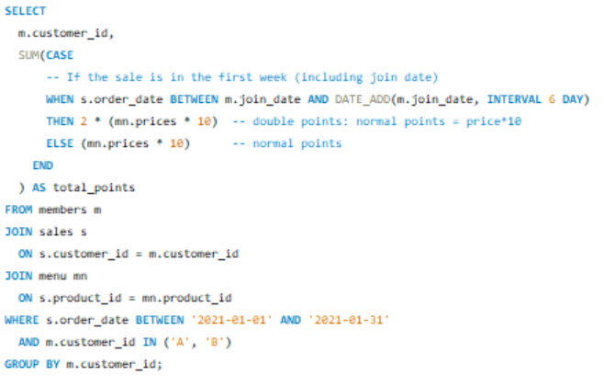
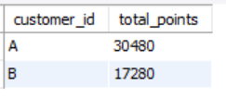
10. In the first week after a customer joins the program (including their join date) they earn 2x points on all items, not just sushi - how many points do customer A and B have at the end of January?

